Slide 1
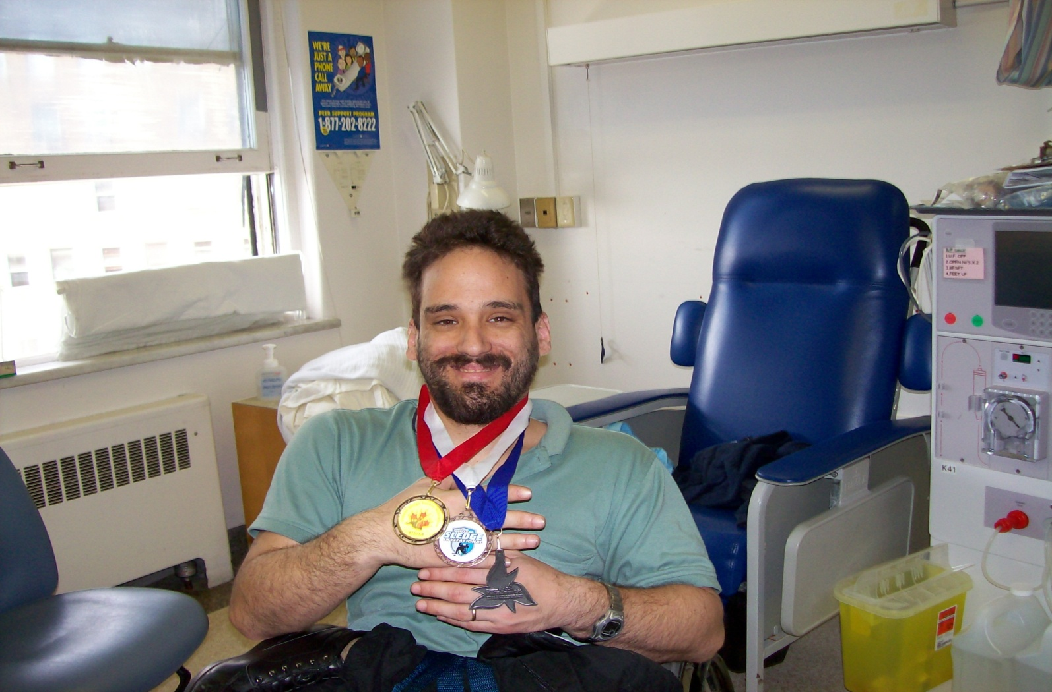
“ There’s No Place Like Home”
Home Hemodialysis Unit

Slide 2
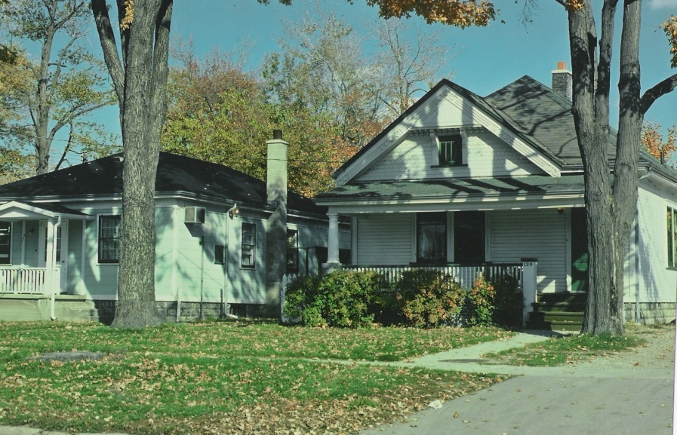
History
Began in London in the early 70’s
Original unit was located in two older homes on Colborne Street near the old Victoria Hospital
In the mid 80’s, there were approximately 55 patients
Patients from all over Southwestern Ontario
One patient at home for more than 30 years

Slide 3
Who Goes Home?
Someone that:
Has motivation to improve their quality of life
Wants to continue to work
Wants independence
Has any vascular access
May live alone, may live in an apartment
Wants more time at home with their family

Slide 4
Why Go Home?
Statistics report increased survival on Home Hemodialysis
Decreased Infections
Increased Independence
Less traveling time
Increased quality of life; dialyzing on your schedule, not the hospitals
Flexible dialysis treatment options
All costs are covered by hospital- utilities not included

Slide 5
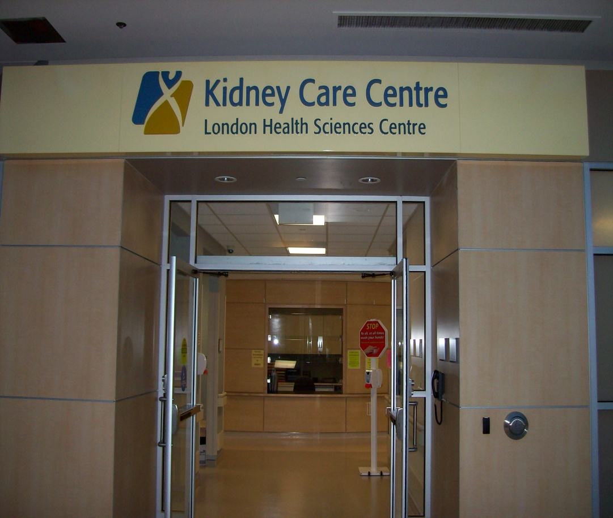
Current Program
Home Hemodialysis is located in Westmount Mall, The Westmount Kidney Care Centre. We train patients for both daytime and overnight dialysis

Slide 6
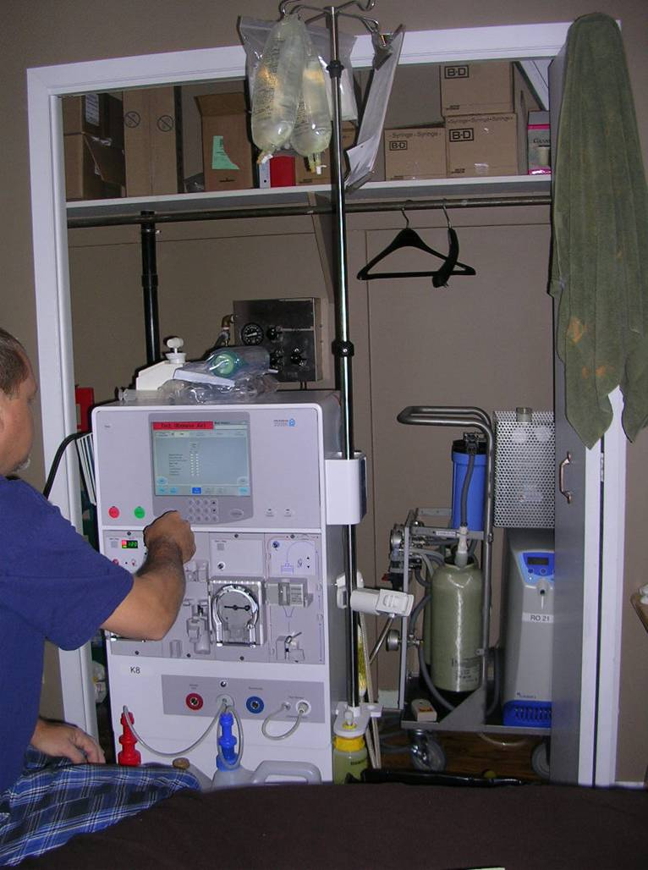
What Do You Need To Go Home?
Referral by staff, nurse practitioner or doctor
Home assessment
Nurse/Social Worker assessment
Complete training course (6-8 weeks of teaching at your own pace)

Slide 7
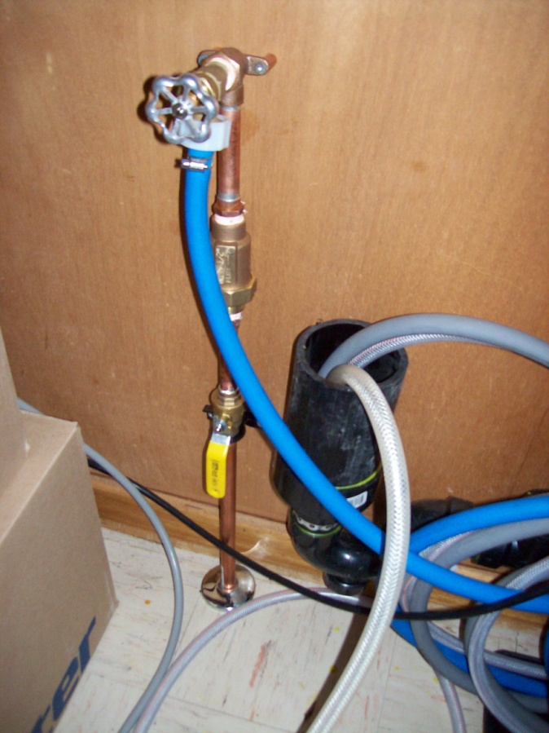
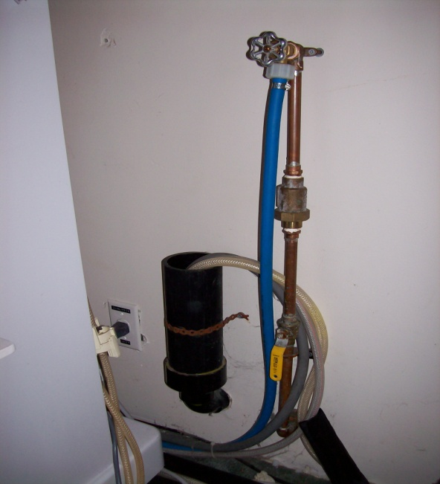
Home Modifications
NEED:
Two electrical outlets
Cold water connection
Drain outlet
Can have a well and septic system
Total water analysis
Electrical and plumbing assessed before starting training
Cost for modifications paid for by OHIP

Slide 8
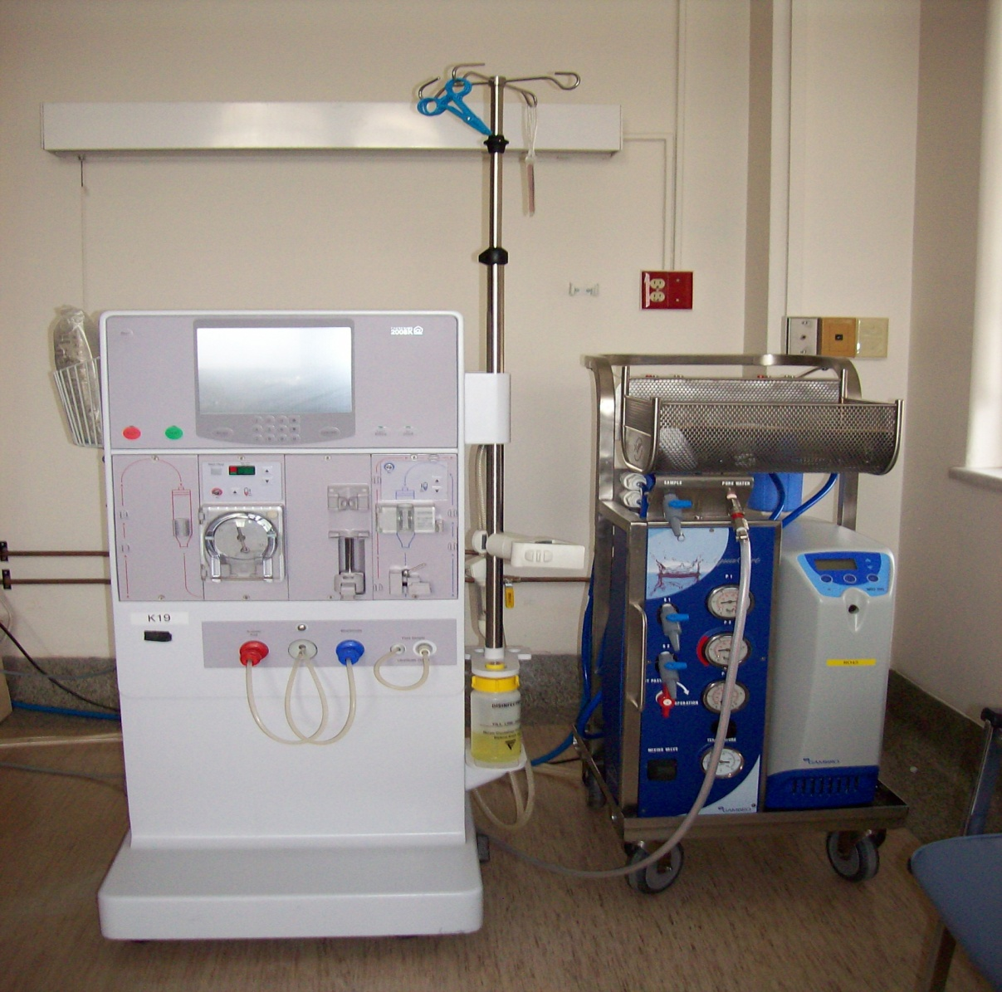
Dialysis Machine & Water System

Slide 9
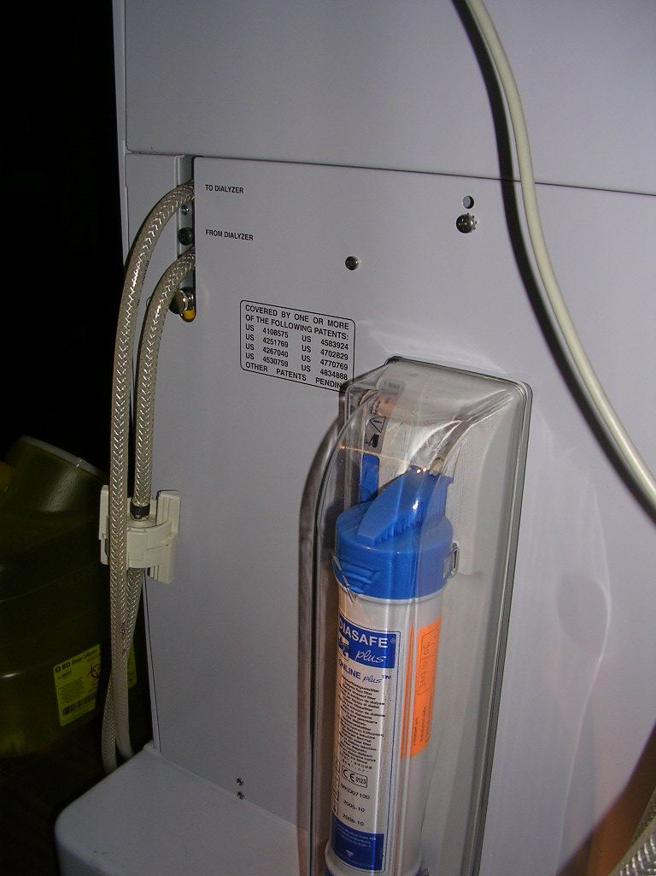
Diasafe Filter
Ultra pure dialysate
Filters easily changed about every three months

Slide 10
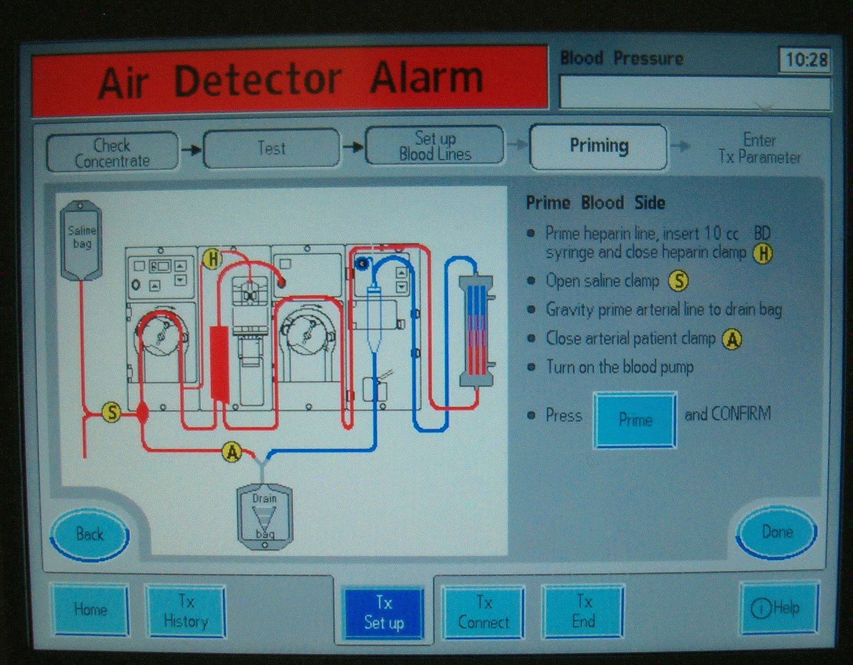
Fresenius K @ Home
Simple
Easy to follow instructions
Specifically designed for home use

Slide 11
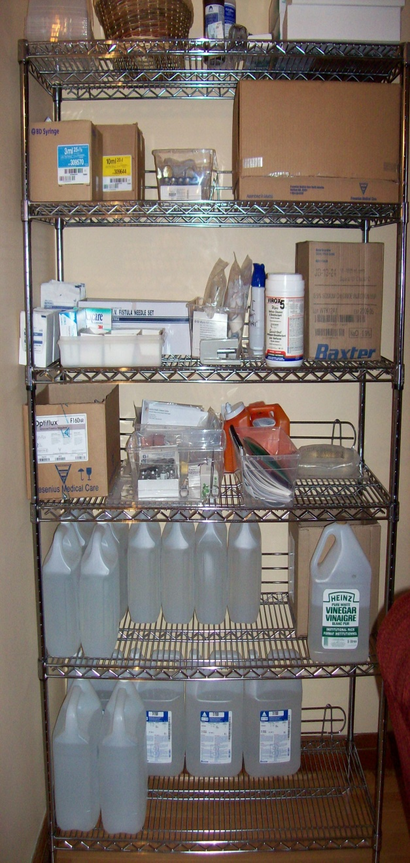
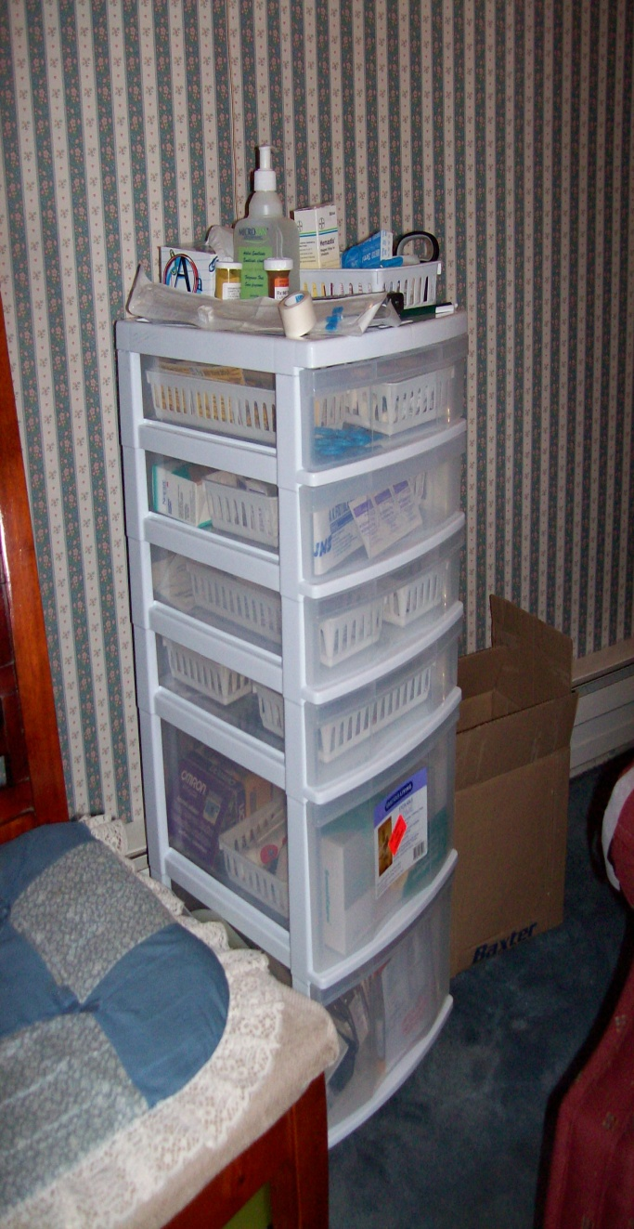
Supplies
Supplies will be stored at room temperature. Solutions are unable to be stored in cold rooms or sun rooms.

Slide 12
Follow Up Once You Are Home
24/7 training nurse on call
Biomed/ Water technical support
Clinic every 1-3 months as needed
Monthly bloodwork done locally
Interdisciplinary team involved (dietitian, social worker, pharmacist)
Bi-annual home visits by training nurses

Slide 13
Travel
Possible with careful planning
Arrangements can usually be made at the closest dialysis clinic to your travel spot
Outside of Canada, there can be costs and additional fees

Slide 14
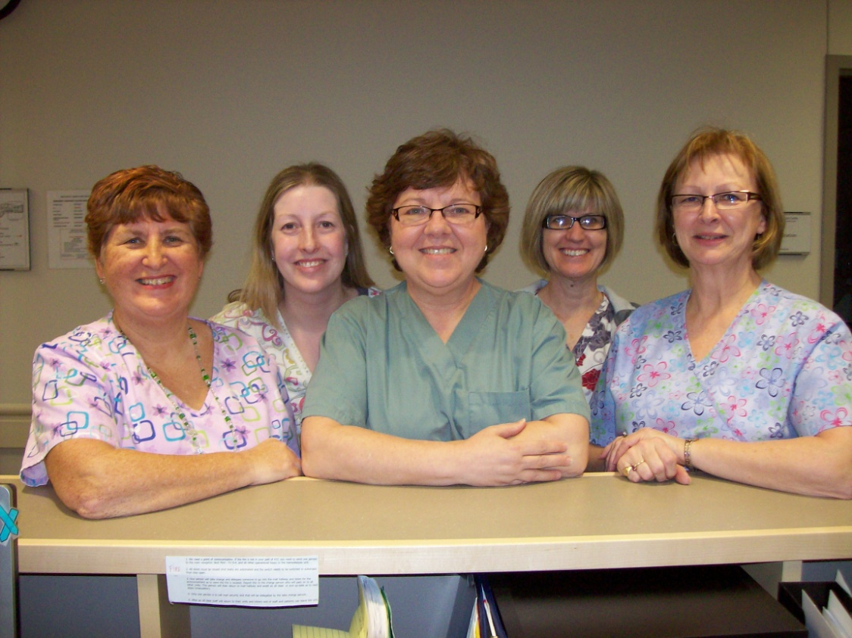
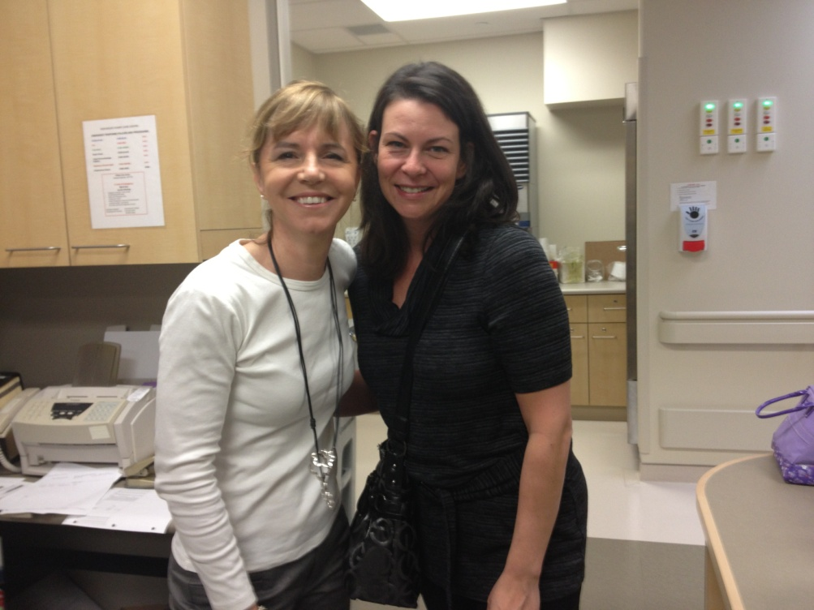
The Team

Slide 15
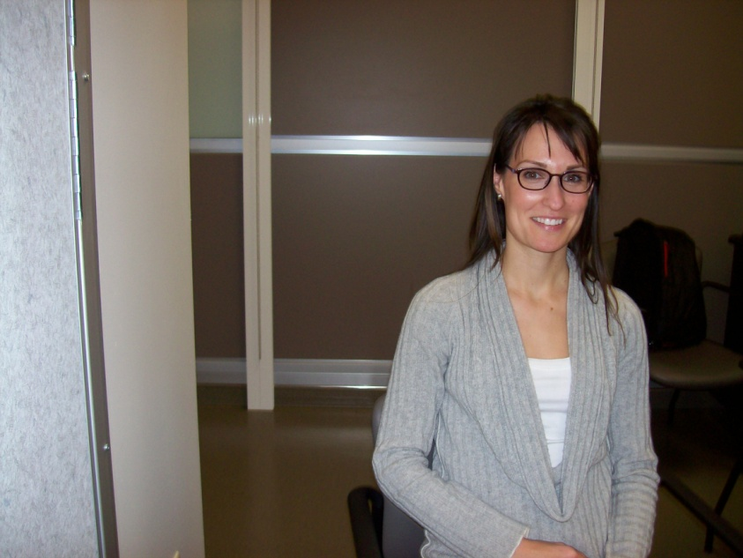
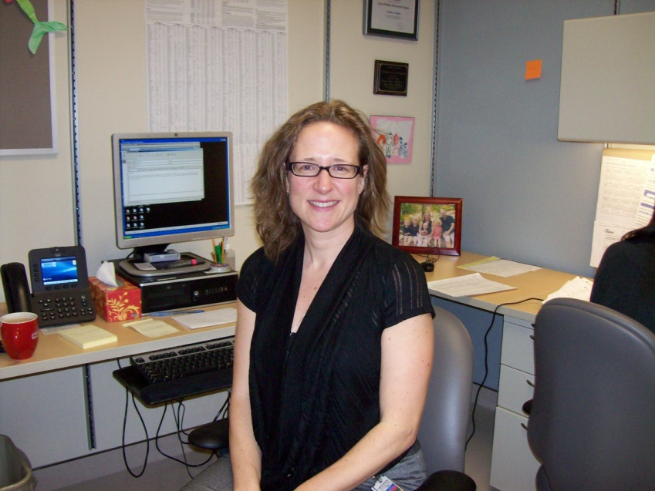
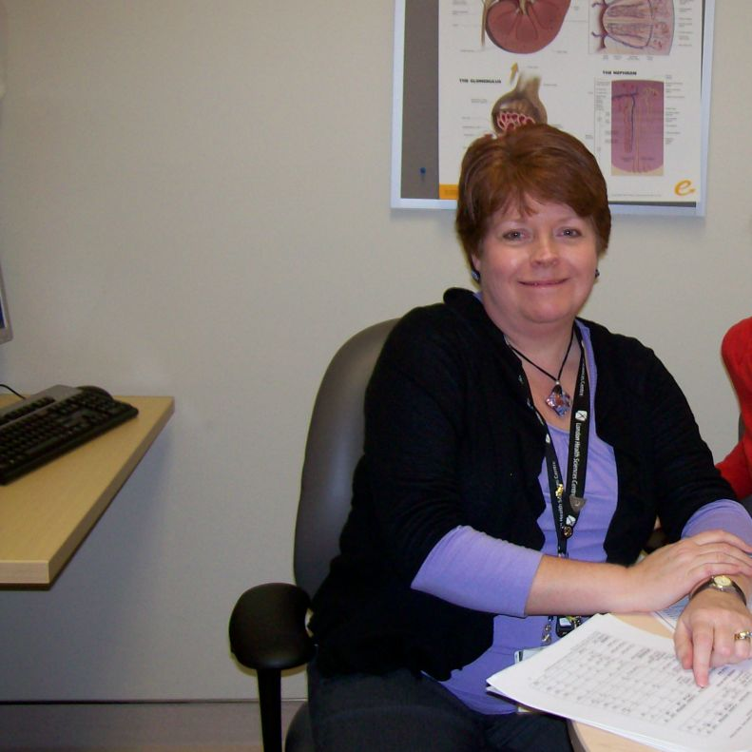
Support Team
Susan
Social Worker
Seadna
Pharmacist
Nancy
Dietitian

Slide 16
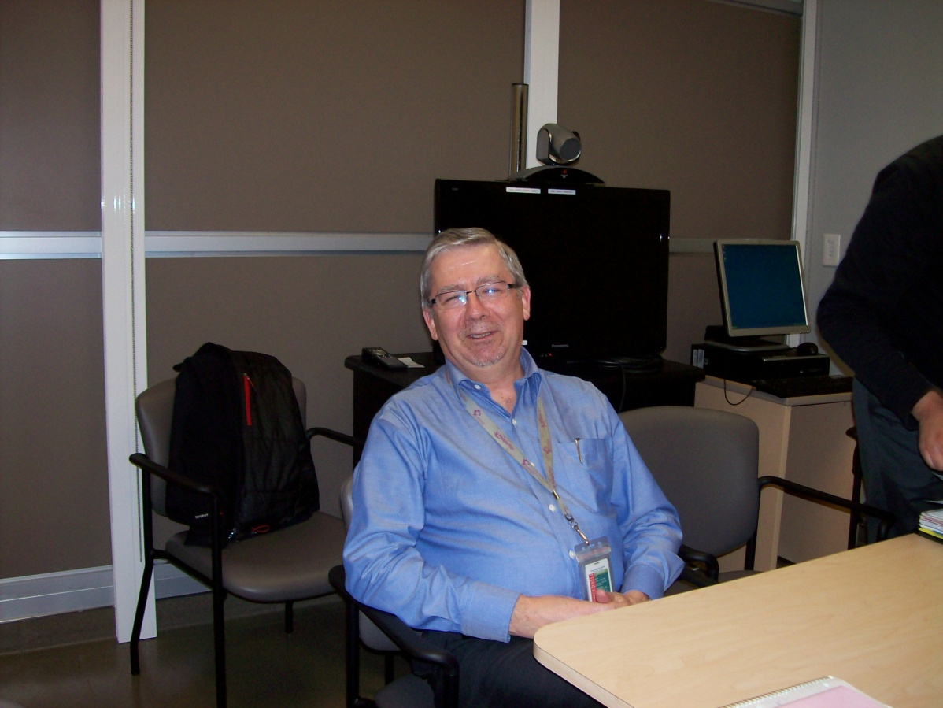
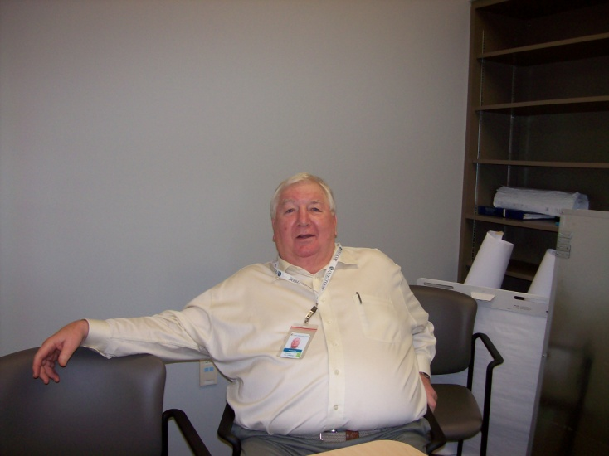
Nephrologists
Dr. Muirhead
Dr. Lindsay

Slide 17
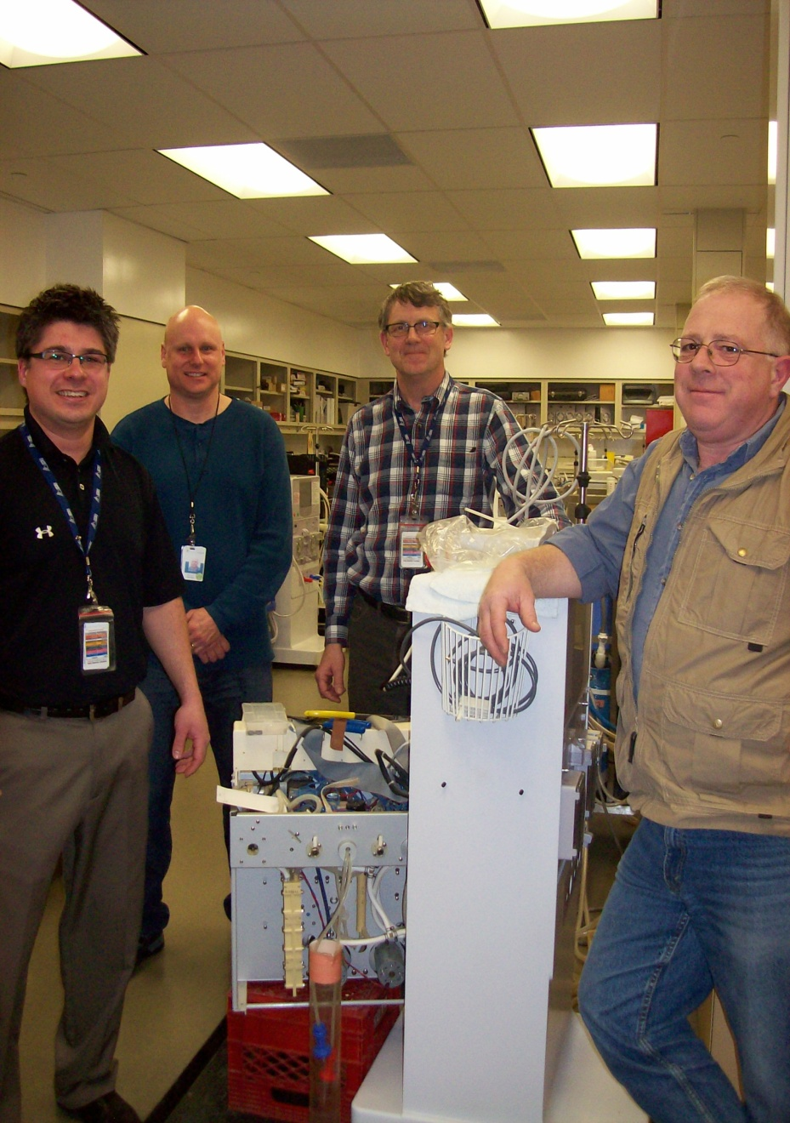
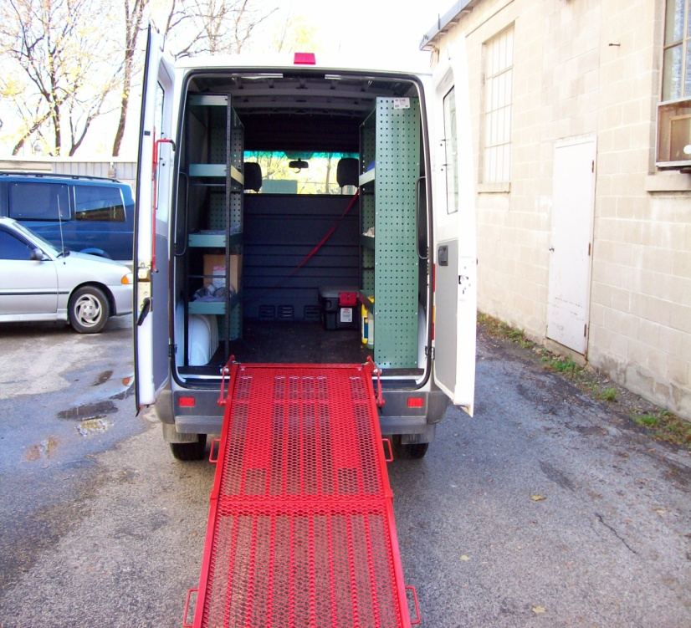
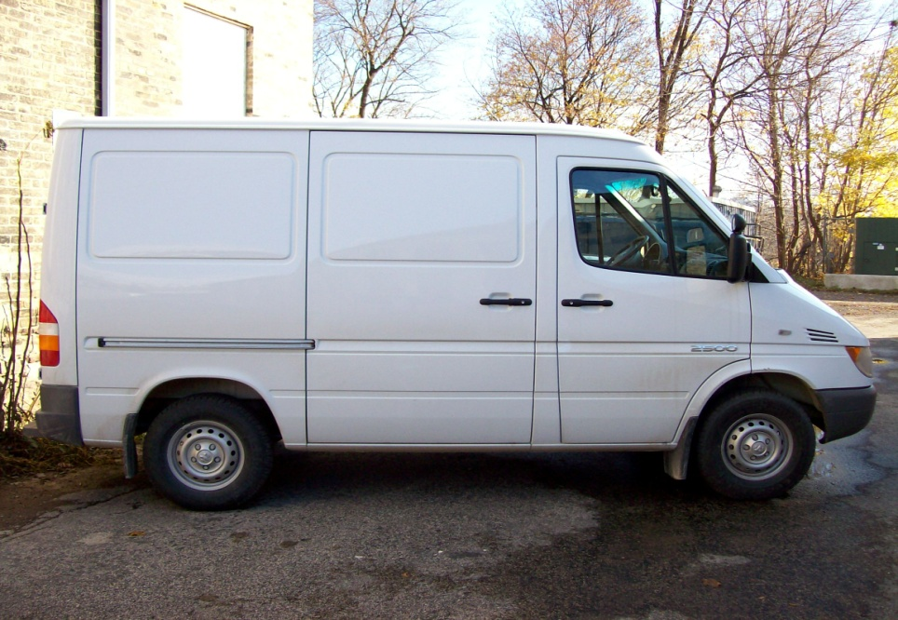
Biomedical Team/Van

Slide 18
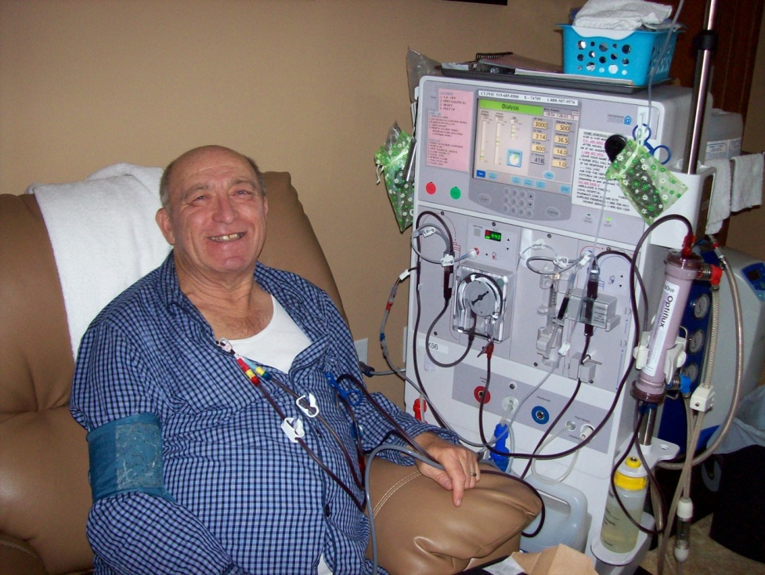
Dialyzing At Home

Slide 19
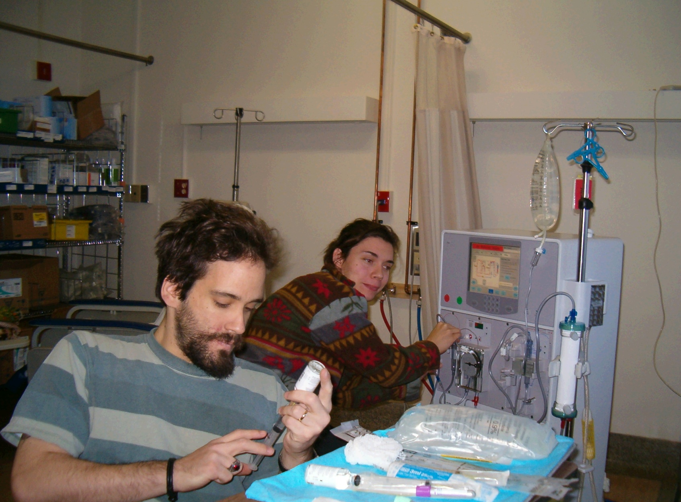
No Barriers

Slide 20
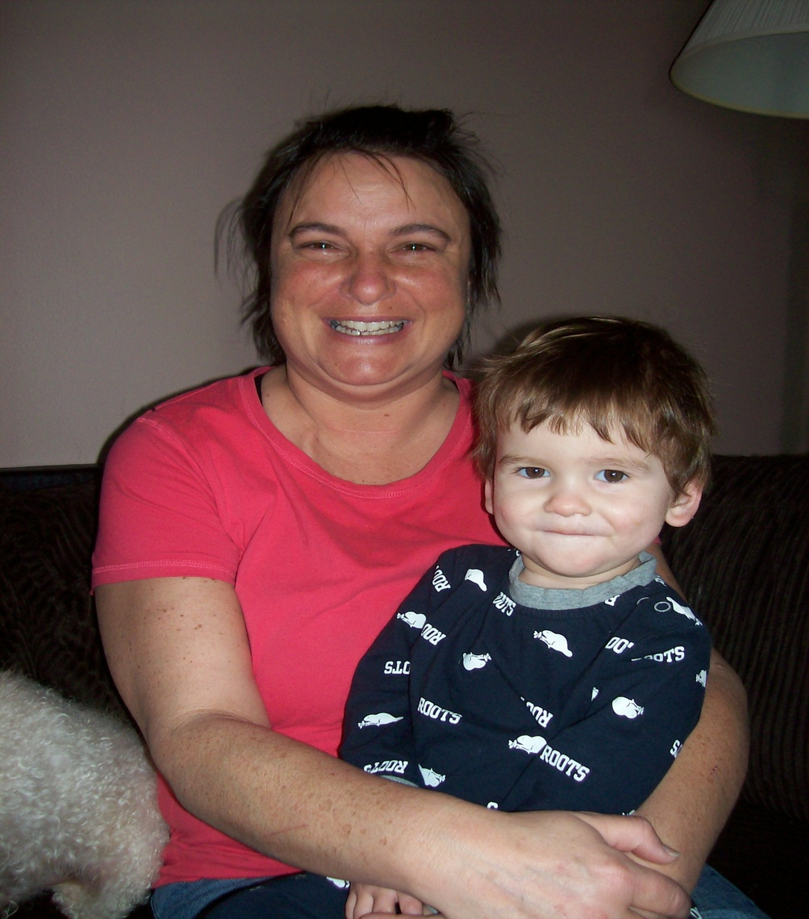
Families Are Always Welcome

Slide 21
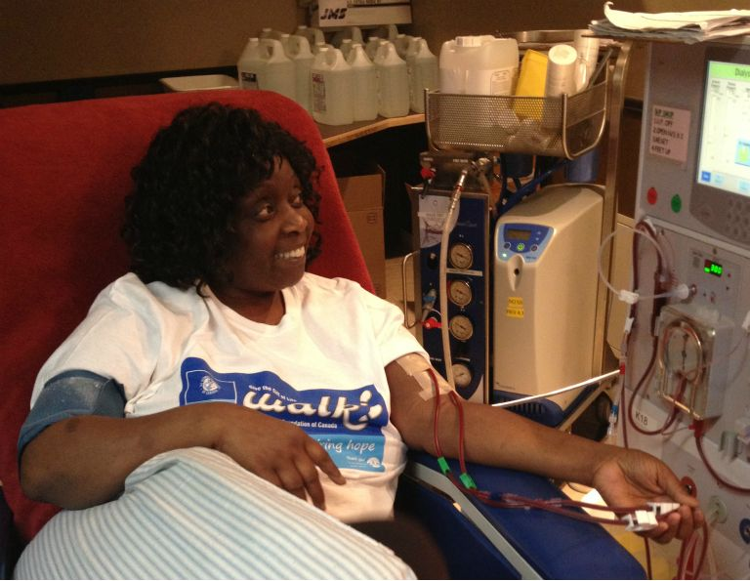
Dialyzing At Home

Slide 22
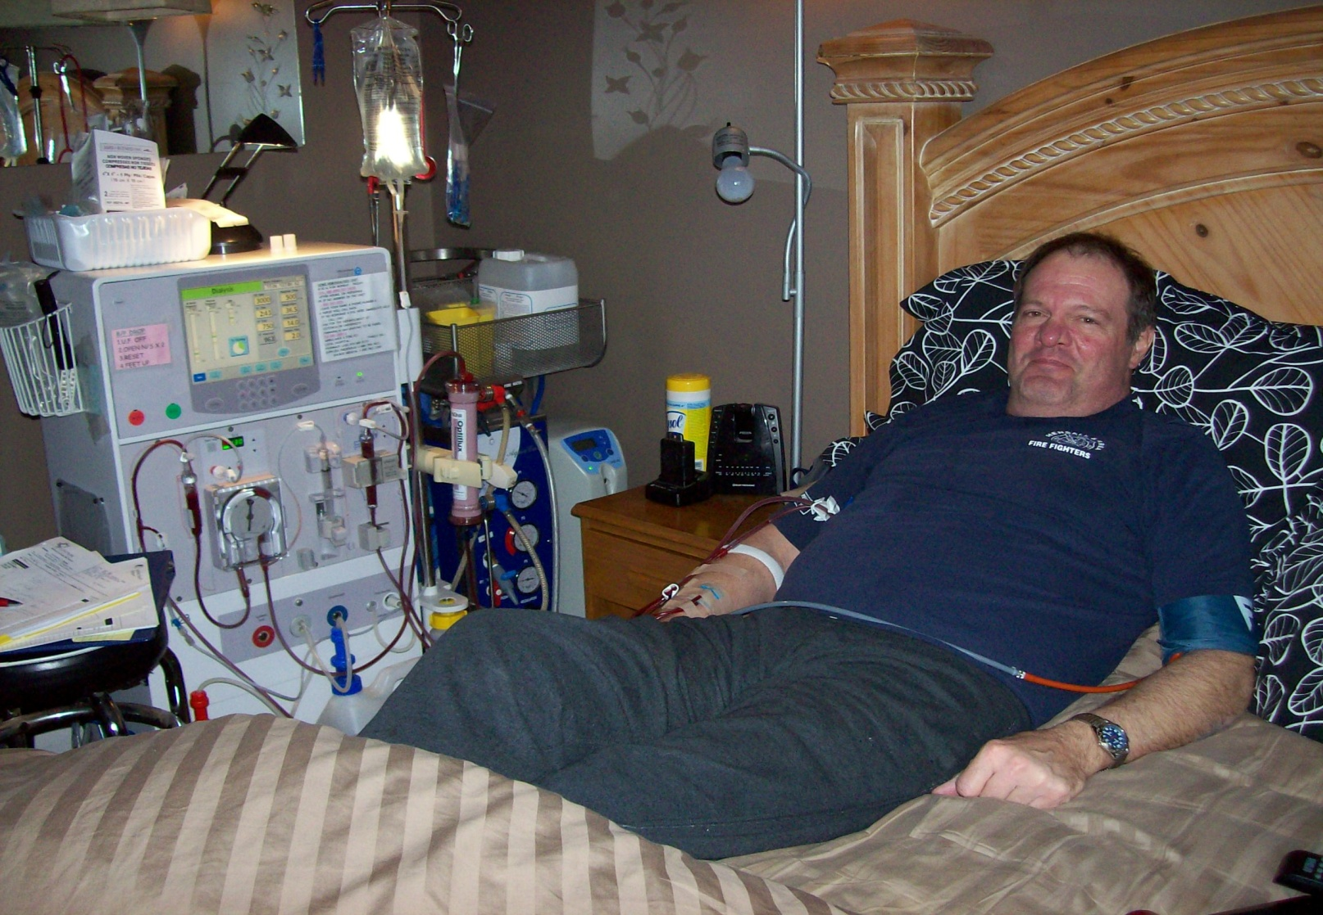
Relaxing, Dialyzing After Work

Slide 23
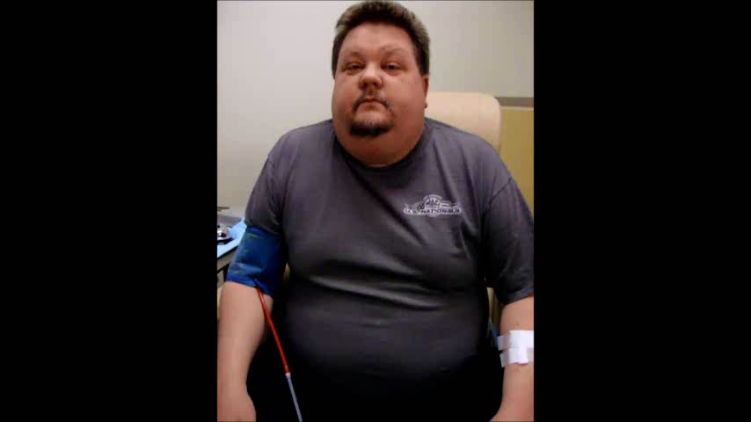
“Why do you like to dialyze at home?”

Slide 24
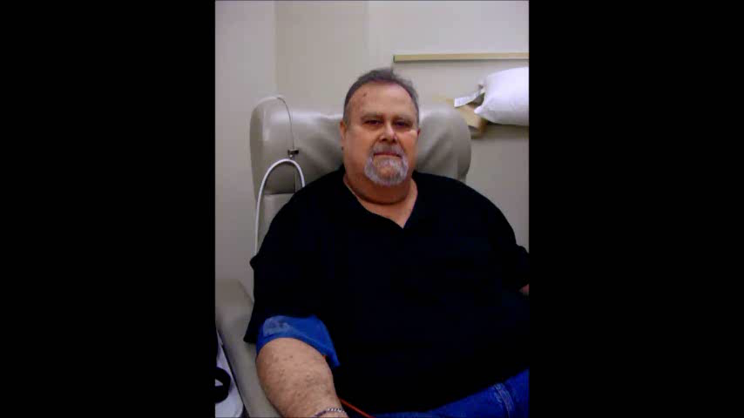
“Why did you choose Home Hemodialysis?”

Slide 25
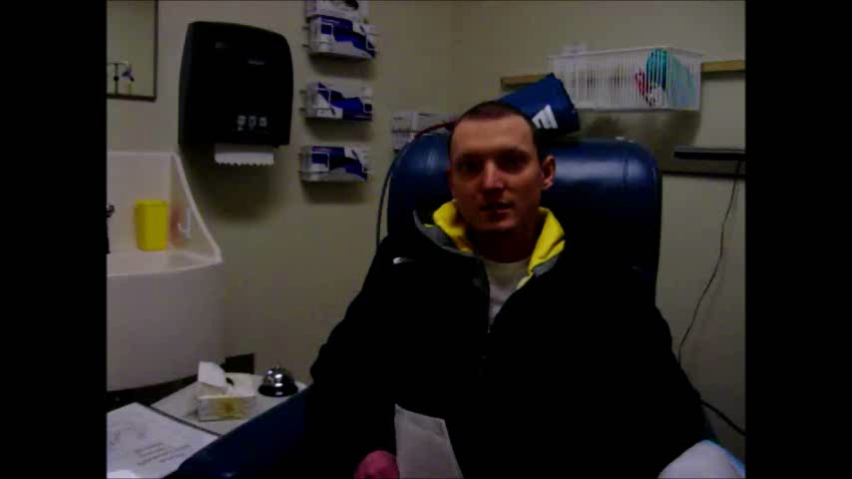
“I was nervous at first…”

Slide 26


The Road To Home Dialysis
Introduction To The Steps In Doing Home Dialysis

Slide 27
At/After Home Hemodialysis Appointment
Yes I want to be considered
Sign a waiver to allow your home to be assessed for suitability (space for supplies, plumbing, water and electrical supply)
Once your home is approved we can arrange a training start date

Slide 28
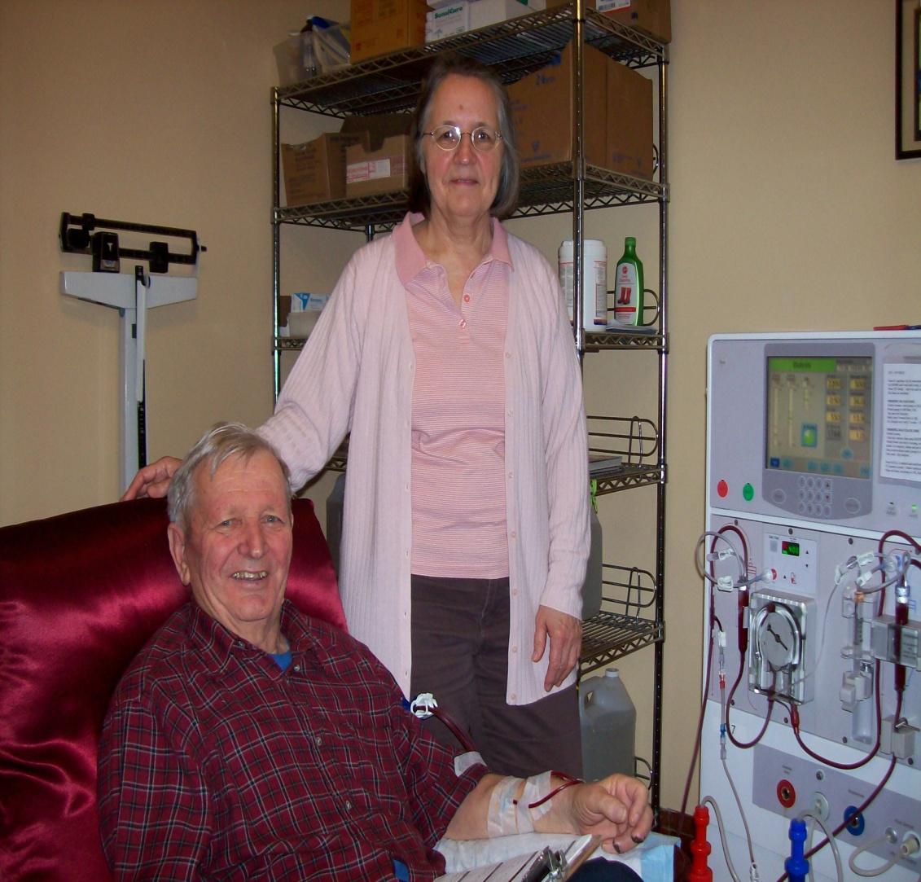
Unsure About Home?
“ Do you want to talk or visit someone who dialyzes at home?”
(Kidney Foundation Peer Support Program)
We welcome any questions - feel free to call us

Slide 29
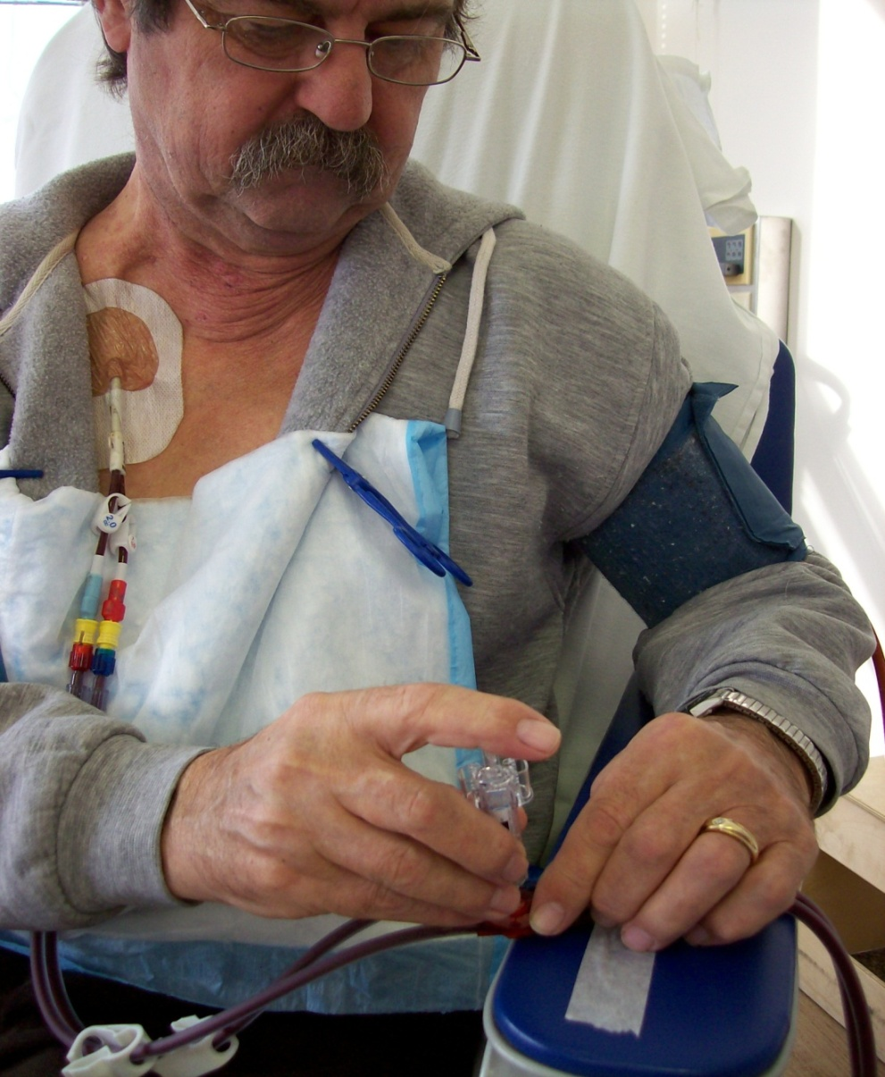
Your Training
The machine will be set up on your first day
Flexible start time between 8:00am-4:00pm
Training days are usually 4-6 hours
You will come 3 days a week for dialysis (Monday, Wednesday, Friday)
Extra days for training are flexible

Slide 30
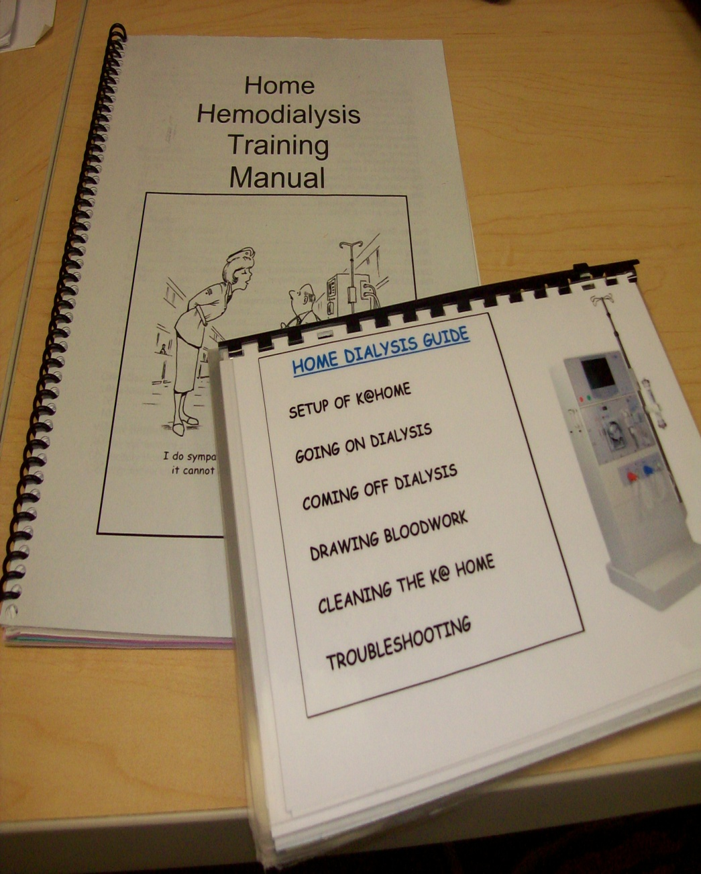
During The Training
You will usually have the same training nurse every day
During training you will be introduced to the Home Dialysis team
You will be given a training book with all the required information
During training you and your nurse will decide if home is right for you

Slide 31
Different Ways To Do Hemodialysis At Home
Home dialysis allows you to choose the frequency and hours of your dialysis treatments
During training you, along with your Doctor and your training nurse can help determine what would work best for you at home
You are free to try the different options until you find what works best for you!

Slide 32
Conventional Hemodialysis
This type of dialysis is the same treatment plan and frequency that you do in a hospital or satellite dialysis unit (usually 4 hours, 3 x per week)
Advantages for home:
  You can flex your days and times as long as you do 3 treatments a week

Slide 33
Nocturnal Hemodialysis
This type of dialysis is done overnight (your sleep time)
You can do this 3 times a week or every night
The length of treatment is 6-9 hours, depending on how long you sleep
With frequent Nocturnal you usually have fewer medications to take and fewer diet restrictions
Remember that the healthy kidney works 24 hours a day so there is no such thing as too much dialysis !

Slide 34
Short Hour Daily Hemodialysis
This dialysis is 2-3 hours, 6 times a week
Short, frequent runs may help with unwelcome side effects of conventional dialysis such as drops in blood pressure

Slide 35
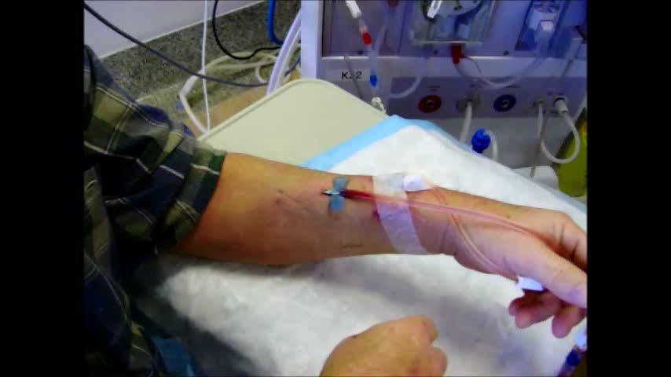
Taking Out Your Own Needle!

Slide 36


Supplies
All supplies used for dialysis at home are paid for by your OHIP
All supplies are delivered to your house monthly

Slide 37
Common Questions
Q. When will I go home?
A. You will go home when you and your nurse think you are ready.
Q. How much time does it take to setup my machine and clean up?
It will take approximately 45 minutes to prepare your machine and another 30 minutes to clean up.
Q. Do I have to insert the needles myself?
A. We will teach you how to needle yourself. If you have a helper they can assist you.

Slide 38
The Follow Up After You Are Home
Visits from training nurse 2-3 times a year
Training nurse on call 24/7 via pager- only a phone call away!
Clinic appointments
  Thursday afternoons
  During clinic you will see the team
  You will come 1 month after first going home, then again in 2 months.
  Following the first 2 months, you will come in every 3 months

Slide 39



