Slide 1
Defibrillation pad vector change in prehospital refractory V-fib
Davis, M., Loosley, J., Schappert, A., VanAarsen, K., McLeod, S., Cheskes, S.
SWORBHP Prehospital and Transport Medicine Research Day

Slide 2
Defibrillation Pad Vector Change
No external financial support or other
conflicts to declare

Slide 3
Introduction
Notes:
Within the CARES registry – large American registry of out of hospital arrests, survival to admission for all arrests is around 25% and to discharge is about 10%.
Survival to discharge is up to 30% in those who have witnessed arrest and have VT/VF, ie. Patients with shockable rhythms tend to do better than those with non-shockable rhythms. What do we do when standard ACLS doesn’t seem to be working though? As the next article titles illustrate, there is a lot of research going on regarding care of patients with refractor V-fib.

Slide 6
Background
Notes:
The next few slides are going to lay some background to quickly get you up to speed with how we got to looking at vector change for prehospital refractory v-fib

Slide 7
A descriptive analysis of prehospital refractory ventricular fibrillation
A. Schappert², B. Chau³, A. Leung³, K Van Aarsen², M. Davis^{1,2}
¹Southwest Ontario Regional Base Hospital Program, London Health Sciences Centre, London, Canada
²Division of Emergency Medicine, Department of Medicine, The University of Western Ontario, London, Canada
³Schulich School of Medicine and Dentistry, The University of Western Ontario, London, Canada
Introduction
Results
When repeated defibrillations fail to terminate ventricular fibrillation (VF), it is classified as refractory ventricular fibrillation (RVF)
Aside from standard ACLS, there is little evidence on appropriate novel treatments for RVF
There is also little data on prehospital factors associated with RVF
Double sequential external defibrillation (DSED) has been proposed as a potential viable treatment strategy
Between Mar. 1, 2012 and Apr. 1, 2016 there were 645 out-of-hospital cardiac arrest calls
193 (29.9%) of these involved at least one analysis of VF, and 90 (13.9%) of total cases were identified as RVF
34 (37.8%) of RVF cases had two or more defibrillators on scene
There was no difference between the RVF and non-RVF groups with respect to age (65.02 vs 67.28, p=0.313) or gender (p=0.132)
There were no differences between the RVF and non-RVF groups with respect to any prehospital factors, including time from activation to arrival at patient (9.00 min vs 8.73 min, p=0.610), time to first shock (11.31 min vs 12.63 min, p=0.122)
There was no difference between groups for incidence of bystander CPR (p=0.840)
Out-of-hospital cardiac arrests
N=645
At least one analysis of VF
N=193 (29.9%)
452 no VF
Objectives
Provide a descriptive analysis of patients in an urban EMS system with RVF
Describe the frequency that DSED may have been utilized in this patient population
At least 5 defibrillations (RVF)
N=90 (46.6%)
103 non-RVF
Conclusions
Methods
In this study population, nearly half of all out-of-hospital cardiac arrests involving VF were refractory
Almost 40% of these cases had the potential for DSED to be utilized as a treatment strategy
There were no measured prehospital patient factors or provider factors that were associated with RVF in this study
Further efforts need to be made to identify those at risk for RVF as well as potential beneficial treatment strategies
A retrospective chart review of Ambulance Call Records (ACRs) for out-of-hospital cardiac arrest was performed for the period of Mar. 1, 2012 - Apr. 1, 2016
RVF defined as ≥ 5 defibrillations
Patient factors of interest included age and gender
Clinical factors collected included time from EMS activation to arrival at patient/time to first shock, and bystander CPR
Descriptive characteristics and clinical factors compared between RVF and non-RVF using Chi-square and t-test where appropriate
30 (37.8%) with ≥ 2 defibrillators
Figure 1. Patient flow of out-of-hospital cardiac arrests during study period.
Notes:
To give some context, I presented a poster at the National Association of EMS Physicians conference in New Orleans early this year
Questions of this study:
How often do we see RVF in the pre-hospital environment?
How often would it be possible to do DSED in the pre-hospital environment?

Slide 8
Quick Summary
4 year review of ACRs
645 OOHCA
193 (29.9%) with at least 1 VF
90 (13.9%) identified as RVF (≥ 5 VFs)
Notes:
As well, 34 (37.8%) of the RVF cases had two or more defibs on scene (manual defibs, not an AED and a manual defib)

Slide 9
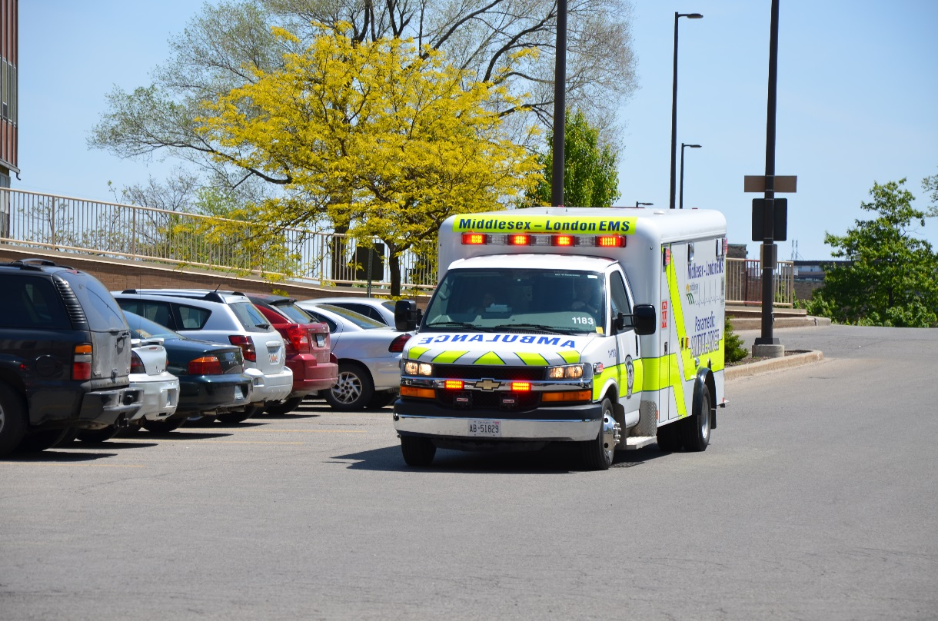
Next question
What happens to this group during transport?
Notes:
What is the initial ED rhythm for those transported in RVF?
Are there any patient specific factors or comorbidities that contribute to persistent RVF?
What percentage of RVF patients survive?
ACRs of patients between 2012 and 2016 were reviewed and ACRs were matched to hospital charts to evaluate the above questions.

Slide 10
Notes:
On transport, a lot of patients with RVF deteriorate and present to the ED with non-shockable rhythms

Slide 11
Notes:
This population also has a low survival rate (although this is still higher survival than those with non-shockable rhythms)
Overall 34 patients (40%) survived to admission, while only 18 (21.2%) survived to discharge.

Slide 12
What can we do prehospitally?
High incidence of refractory VF (up to 30%)
Double Sequential Electrical Defibrillation?
Multiple energy vectors increases shocked myocardium?
Shock timing?
Change in vector?
Notes:
Despite the relatively high incidence of RVF (up to 30% in some studies) there isn’t really a focus on optimal management of this patient population
There are multiple theories about why DSED might work, but none have really been supported more than any of the others

Slide 13
Methods
Ambulance Call Records (ACRs) between Mar. 2016 and Feb. 2017
Included patients presenting in RVF (defined as ≥ 5 consecutive VF analyses)
Treatment was pad vector change (change from AA to AP after 3 consecutive defibrillations)
Compared VF termination and ROSC between vector change and no vector change groups

Slide 14
Results
372 OOHCA
25 (6.7%) in rVF
16 Vector Change (64.0%)
9 No Vector Change (36.0%)
Notes:
During study period 372 OOHCA with small percentage in RVF.

Slide 15
Results
 | Vector change (n=16) | No vector change (n=9)
Termination of VF after 4th defibrillation n (%) | 8 (50%) | 0 (0%)
Achieving prehospital ROSC n (%) | 6 (37.5%) | 3 (33.3%)
Survival to hospital discharge n (%) | 5 (31.3%) | 3 (33.3%)

Slide 17
Conclusions

Slide 18
Limitations and Future Directions
Small sample size

